Slide 1


AUTOMATIC DETECTION
OF THE OCCUPATION OF
A SPACE
- Ivan Zelenyy (m307924)
- Diana Savchuk (m307835)
- Sabina Pun (a43643)

Slide 2
THE MACHINE LEARNING
PROCESS
1.Import Data
3. Explanatory
Data Analysis
5. Testing
6.Optimization
&
Tuning
2. Pre-Processing
4. Training

Slide 3
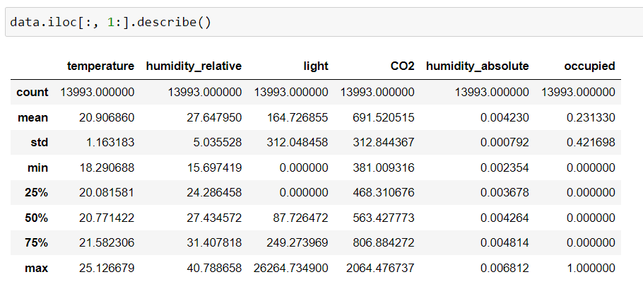
Import the dataset
Collecting the dataset
Also, imported all the required libraries.
Using .iloc property and slicing feature, we
excluded column ”id” which does not seem to be
mentioned as feature variable. Also, we came to
know that correlation between id and occupied
was 0.
1.Feature variables (independent variable) » temperature, humitdity_relative, light, CO2, humidity_absolute
2.Target (dependent variable) » occupied

Slide 4
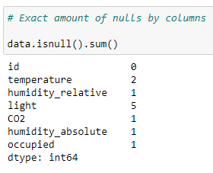
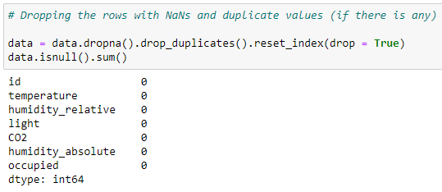
Pre-Processing
Using .isnull() method to detect missing values represented as NaN in pandas.Also,found out some NaN values in every feature columns.
Removing all the rows with Nan and duplicate values in the data before Algorithm feeding it to Algorithm

Slide 5
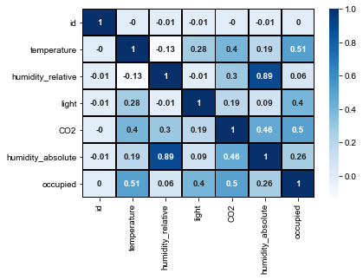
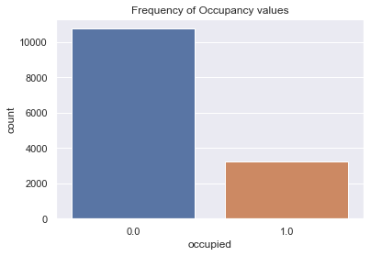
Exploratory Data Analysis
Summarizing their main characteristics,often with visual methods.We can see clearly the relationship between variables like how one variable is affecting other.
Through correlation matrix,we can see correlation between different features of our dataset.”temperature” and “humidity_relative” are negatively correlated with each other while “humidity_relative” and “humidity_absolute” are the most positively correlated.
Through bar plot,we can see the frequency of occupancy values.
describe function allows us to get various summary statistic like count, mean,standard
deviation,maximum and minimum values.

Slide 6

Split the data to Train and test the model
At the beginning, splitted the dataset into training and testing subset. We used 70% of data as training set and 30% of dataset as testing. Also used random_state = 1 to take same sample every time.
Train_test_split : splits data arrays into two subsets: training and testing
Test_size = 0.3 : splitted data in proportion of 70:30
Random_state : 1
Stratify : sampling technique where samples are divided in the same proportion

Slide 7


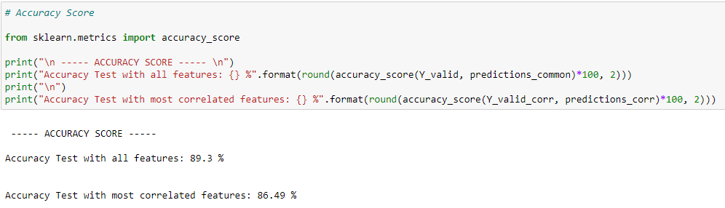
The Logistic Regression model
After we import the right library (LogisticRegression from sklearn), we create an instance and then train our model.
As soon as we trained our model, we predict the target feature.
We estimate the prediction performance with accuracy score method.

Slide 8
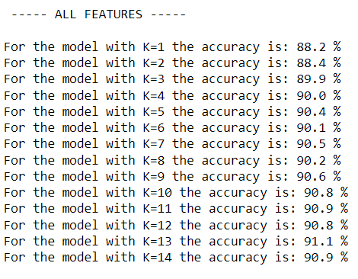
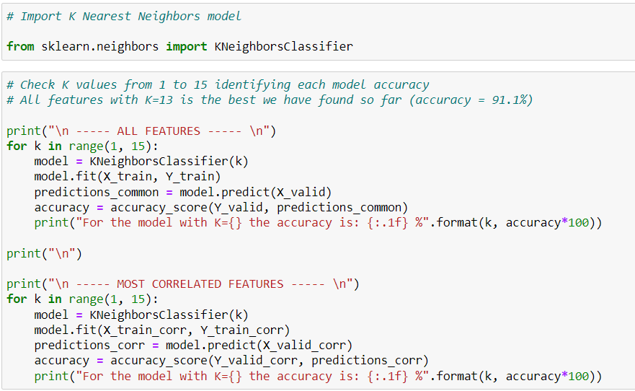
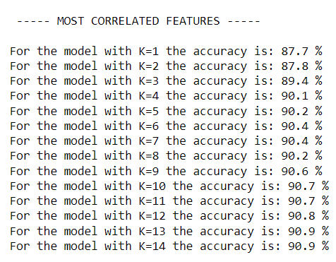
The K Nearest Neighbors model
On this slide, we import K Nearest Neighbours model and checking k values from 1 to 15 identifying each model accuracy.

Slide 9
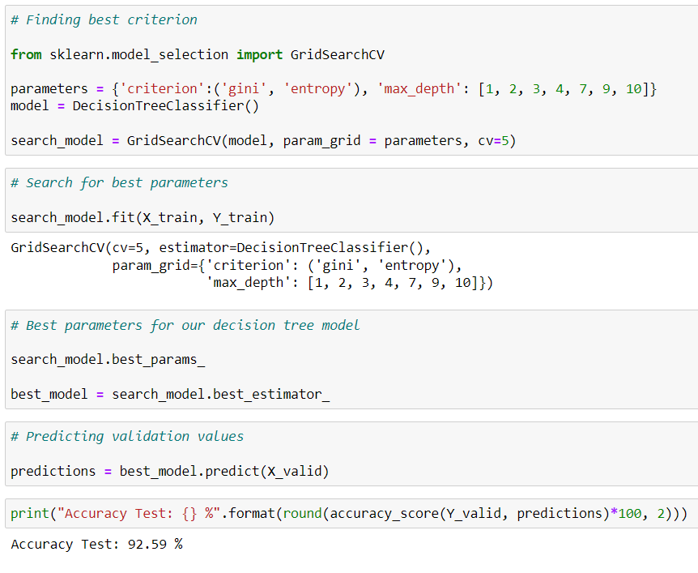
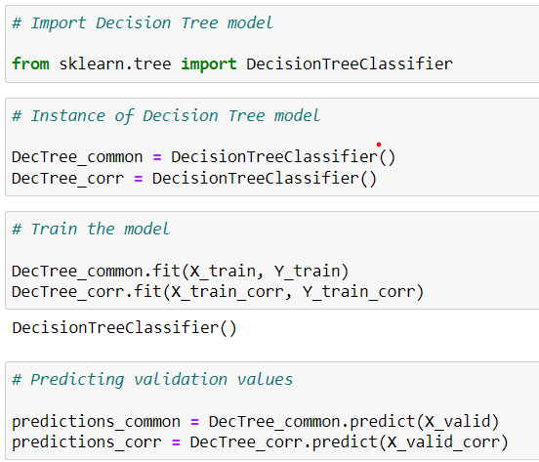
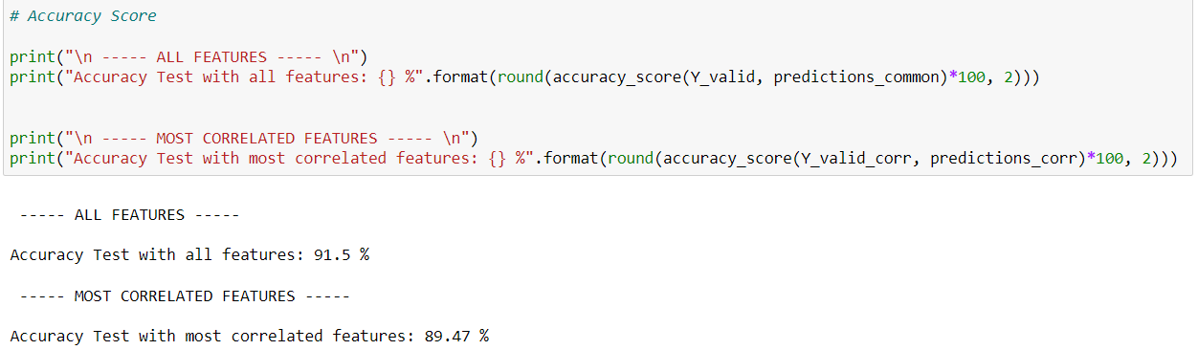
The Decision Tree model
On this slide, we import and train Decision Tree Model, searching for best parameters for it.

Slide 10

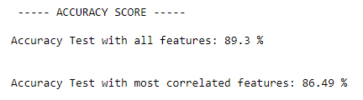
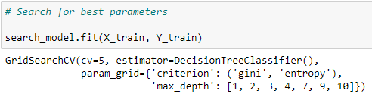
Optimization & Tuning
For every model we tried to find the best parameters. Logistic Regression & K Nearest Neighbors
Logistic Regression & K Nearest Neighbors use the data of most correlated features with the target (check correlation matrix)
The same is correct also for the Decision Tree model. However, using model_selection module of sklearn, we found the best criteria, so that now it is the model with most accuracy rating (always with more than 92.4%)
Every model has shown us that train model with all features is better than with most correlated (accuracy rating for Logistic Regression)

